Slide 1

Explaining ML Models with LLMs
Avi Levin
PyData 2024

Slide 2
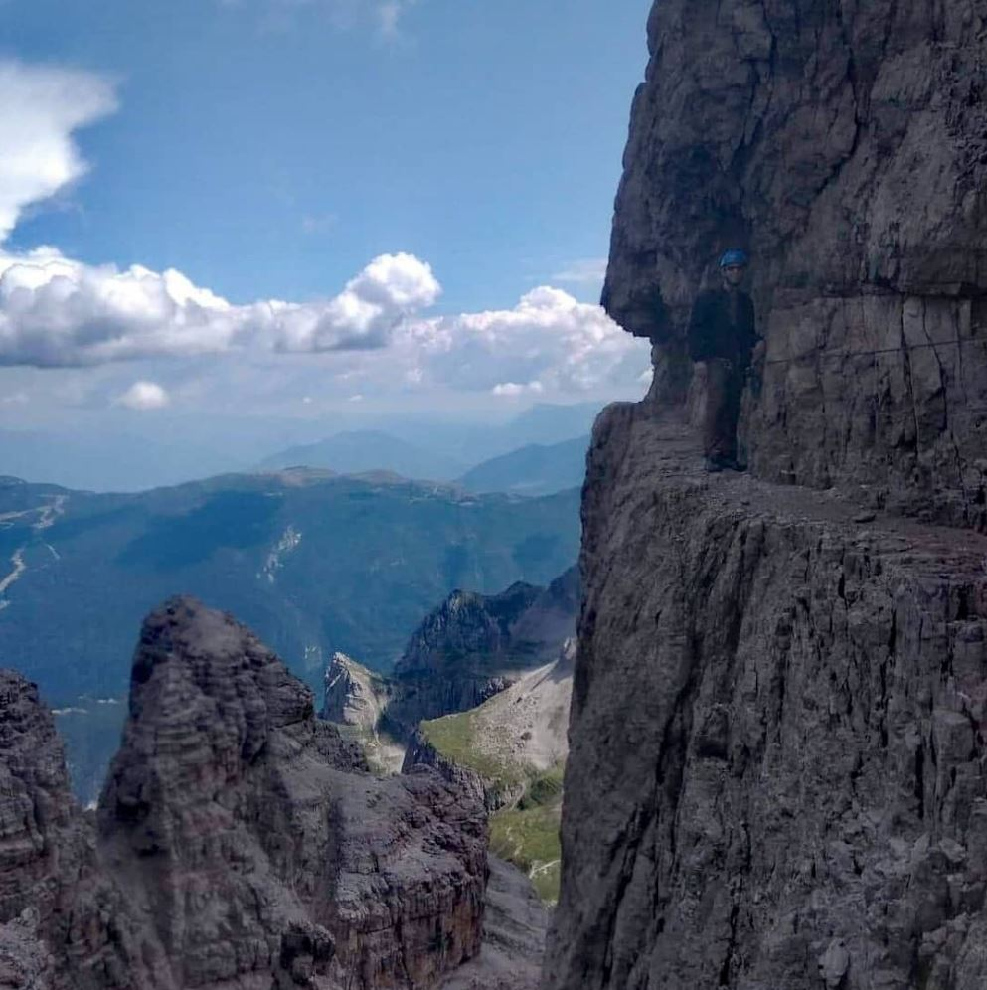
Who Am I? 🤔
Lead Data Scientist at Citi’s Innovation Lab.
Master’s thesis on XAI.
First time at PyData (and in US), so bear with me if I look like I’m climbing a mountain up here! 🧗‍♂️
Notes:
Lead Data Scientist at Citi’s Innovation Lab, where I’ve spent the past 6 years trying to make AI both smarter and easier to understand.
Master’s thesis on XAI because I love explaining things—to people and to machines.
First time at PyData, so bear with me if I look like I’m climbing a mountain up here! 🧗‍♂️

Slide 3
XAI benefits & Stakeholders
Stakeholders:
Model developers (you?)
Decision makers (e.g doctors, judges)
Model Risk Managment
Benefits:
Debugging
Bias detection
when can we trust model predictions
Clear insights
Ensure model compliance
Notes:
MRM – model risk managment

Slide 4
XAI Challenges & LLMs Opportunities
Challenge | LLMs Opportunity
Not context aware - domain knowledge | Domain knowledge from prompt, training and RAG
Lacks summarization capability | Summarization of texts and images
Not flexible for different stakeholders | User-friendly model and metadata explanations
Can't ask follow up questions | Interactive explanations
Notes:
Challenges:
Not flexible for different stakeholder preferences (eg. non technical domain experts)
Technical metrics that can be hard to understand
Can't ask follow up questions (Not interactive)
Can take time to go over it as it lacks summarization capability
Not context aware - domain knowledge (eg. does it correspond to known phenomena in the literature?)
Opportunities:
User-friendly model explanations (from classic XAI methods)
User-friendly metadata Explanation
Interactive explanations

Slide 5
What We are Going To Talk About?
Describe simple method to make XAI explanations more user friendly and to summarize them
Evaluation
Risks and mitigations
Notes:
instead focus on using LLMs to transform existing ML ex planations, generated by theoretically-grounded explanation algorithms such as SHAP [13], into natural language narra tives.

Slide 6

Notes About Examples
All Examples will be based on Bike sharing dataset
It has 731 daily samples, target is the total rental bikes (2011 and 2012)
You play yourself with the accompanied examples in : https://github.com/avilog/shap2llm
Notes:
Bike Share Daily Data from Hadi Fanaee-T, Laboratory of Artificial Intelligence and Decision Support (LIAAD)

Slide 7
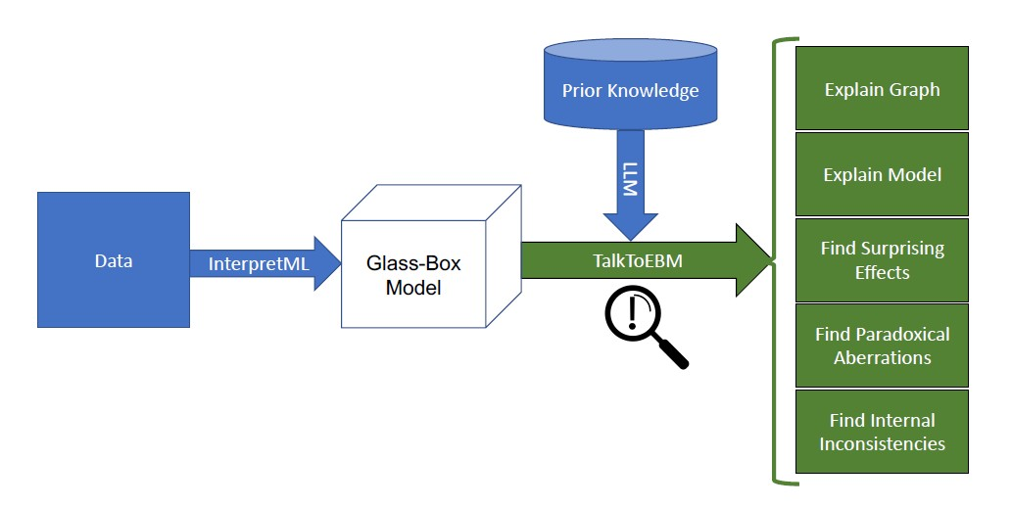
Inspiration: Talk2EBM (2023)

Slide 8
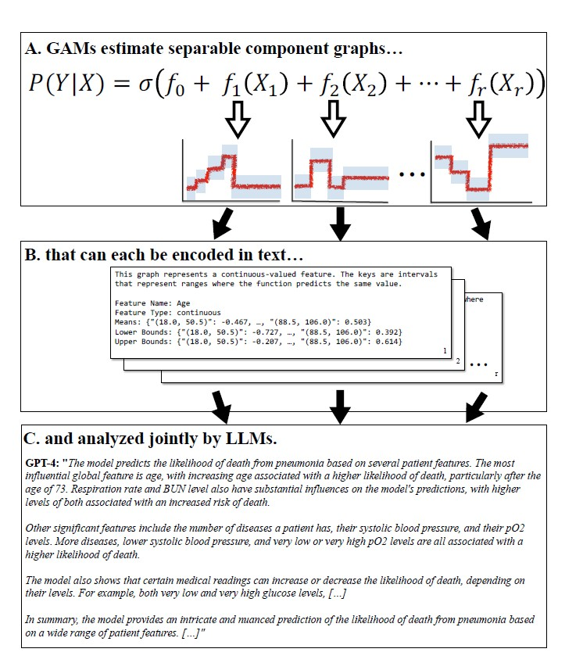
Talk2EBM

Slide 9
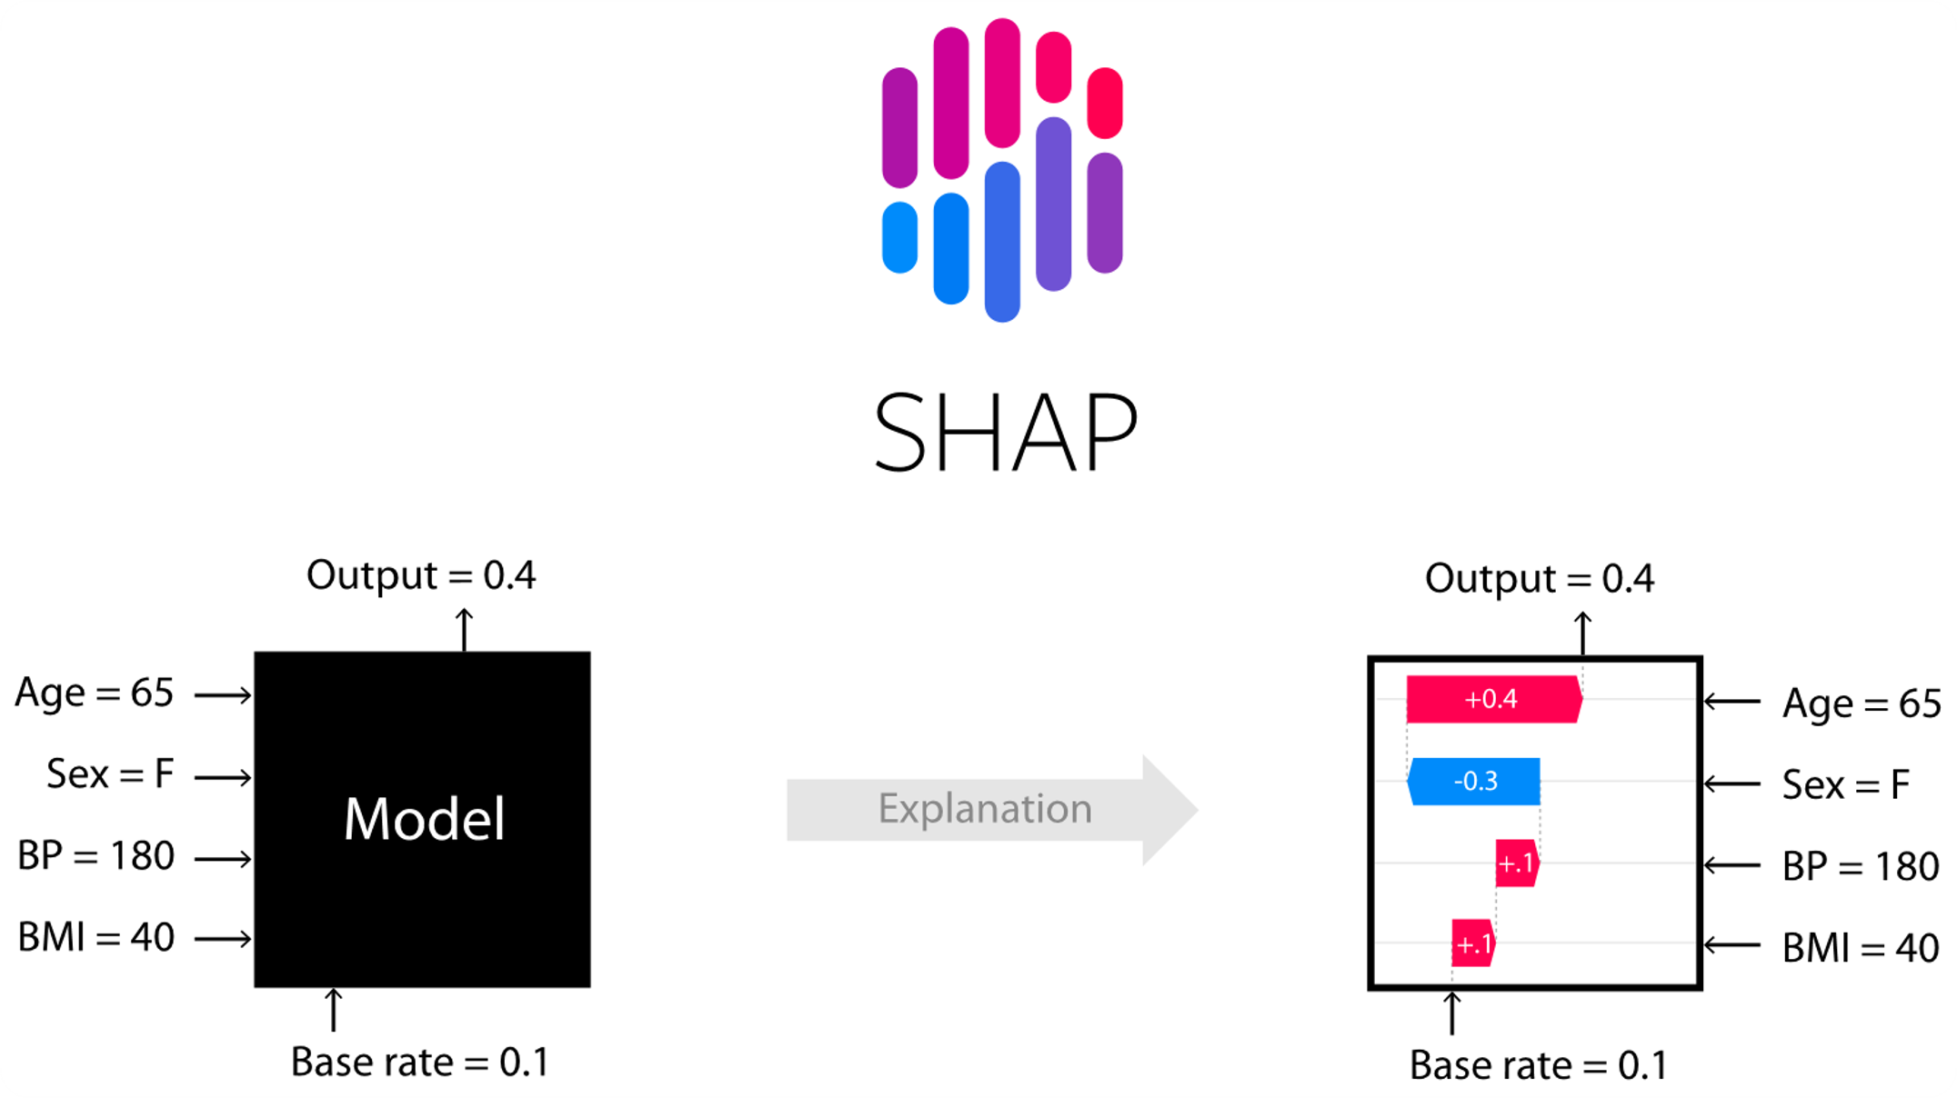
Background

Slide 10
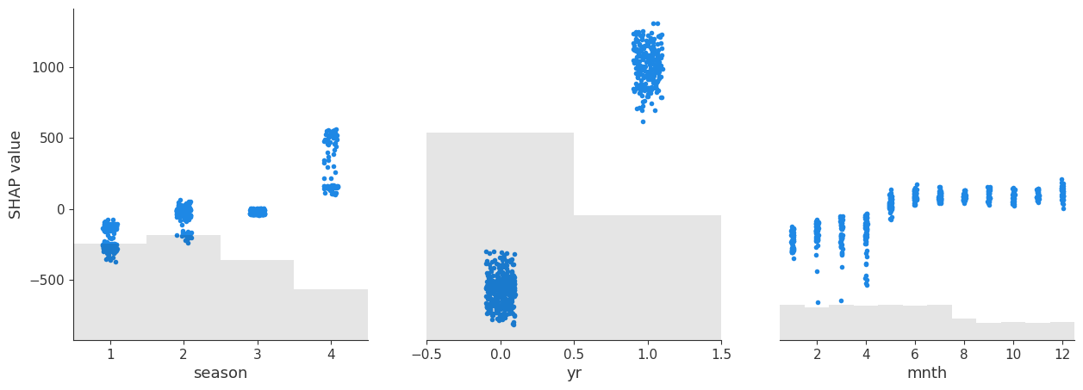
Our Method: Shap2LLM
Data
Shap Scatter plots per feature
Explain plots with LLMs
Model

Slide 11
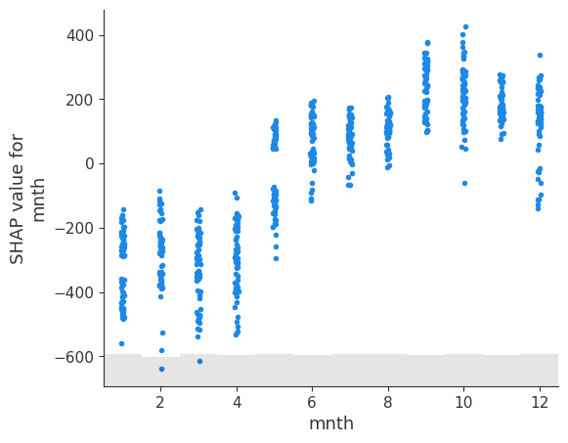
Explain Feature Plot: Month

Slide 12
Explain Feature Plot: Month
Dataset: Bike-sharing ...Washington D.C., USA ...
ML model task: the model predicts daily count of total rental bikes Feature name: mnth
Feature description: month (1 to 12) Features type: int64
The SHAP value for the 'mnth' feature generally increases from January (1) to December (12), indicating that bike rentals are predicted lower in the early months and higher in the later months. There is a noticeable shift from negative SHAP values in the early months (January to April) to positive values in the later months (May to December), suggesting a seasonal pattern in bike rentals, likely due to weather and seasonal changes influencing cycling habits in Washington D.C. This aligns with the expectation that warmer months encourage more rentals, while colder months deter them.

Slide 13
Chain Of Thought Reasoning Prompt
Example | Step
The graph shows how the month of the year (x-axis) affects the SHAP... | Describe the general pattern of the graph.
An interesting aspect of this graph is the consistent trend of increasing... | highlight any regions you may find surprising
The SHAP value for the 'mnth' feature generally increases from January (1) to December (12... | provide a brief summary, at most 7 sentence description
Using Structured output to reduce calls
Notes:
Instead of just asking the final answear directly (Summarize the graph) we ask him to think step by step. They help in icreasing accuarcy and in making sur the LLM realy understand the graph

Slide 14
Risks & Mitigations
Hallucinations: Add better descriptions, Use bigger model, Use RAG.
Privacy: Ask for rules, train models with privacy gurantee
Cost/Latency: Send low quality images, Use smaller models (40 mini).
Computing Shapley value take long time: use other method like partial dependacy plot

Slide 15
Summary
Simple model to get explantiosn and find domain knowledge suprises on any model
Can explain other XAI method
Future extensions: Add dashbaord, Add quantitative evaluation

Slide 16
Appendix

Slide 17
Read More (Papers + Code):
Code | What they showed | Title
https://github.com/dylan-slack/TalkToModel | Created interactive interface to use LLM to explain models | Talk2Model
https://github.com/interpretml/TalkToEBM | show that GPT-4 is able to describe univariate graphs, and can can operate on component summaries to produce model-level analys.e They converting the graphs to text and showed only on GAM model. | Talk2EBM
https://github.com/sibyl-dev/Explingo | Showed how to narrate with LLM local shap explantion and how to evaluate it | LLMs for XAI

Slide 18
Improve Meta Data
"'You are helping users understand an ML model features. Given table name and features information .. "
New Description | New Name | Old Description | Old Name
Denotes the month in which the bike rental data was recorded, | Month | month (1 to 12) | mnth
A binary indicator showing whether the rental day was a holiday | Holiday Indicator | weather day is holiday or not | holiday

Slide 19
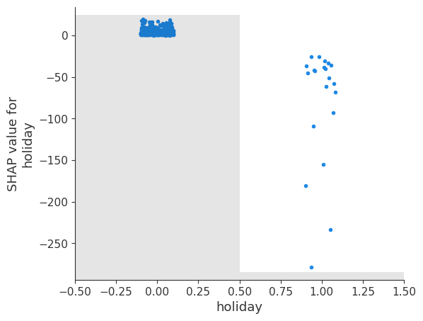
Explain Feature Plot: Holiday
Dataset: Bike-sharing ...Washington D.C., USA ...
ML model task: the model predicts daily count of total rental bikes Feature name: Holiday
Feature description: if holliday
Features type: Boolean
The plot illustrates the impact of the 'holiday' feature on bike rental predictions. On non-holidays (value 0), the SHAP values are around zero, indicating no significant impact. On holidays (value 1), SHAP values are mainly negative, suggesting that holidays lead to fewer bike rentals. This pattern aligns with reduced commuting needs on holidays, causing fewer rentals. The disparity between SHAP values for holidays and non-holidays is the most notable finding, reflecting the real-world effect of holidays on commuting behavior."

